Slide 1





Congresso Nazionale SICOB Sorrento 29-31 Ottobre 2025
Timing della Chirurgia Bariatrica nel Paziente Oncologico

Slide 2




Congresso Nazionale SICOB Sorrento 29-31 Ottobre 2025
When Cancer is NOT (or may not be) a Contraindication
Previous Cancer History
Concurrent Cancer
Risk Reduction
5-year disease-free survival is not required before bariatric surgery (anymore). Decision based on cancer type and individual risk assessment.
Bariatric surgery may reduce risks of cancer treatments, improve surveillance efforts, and decrease second primary malignancy risk.
Studies show 60% decrease in long-term cancer mortality and 24% reduced cancer risk post RYGB.
Gagne DJ, Papasavas PK, Maalouf M, Urbandt JE, Caushaj PF. Obesity surgery and malignancy: our experience after 1500 cases. Surg Obes Relat Dis 2018

Slide 3
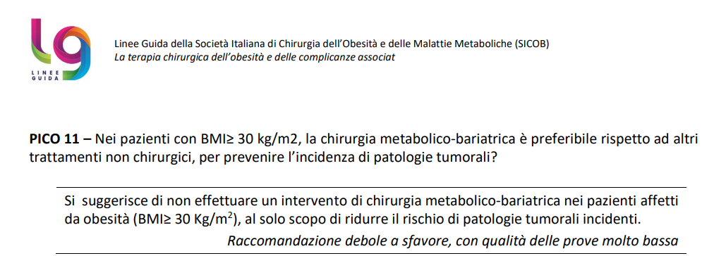
Congresso Nazionale SICOB Sorrento 29-31 Ottobre 2025
Bariatric Surgery to prevent cancer ???
Linee Guida della Società Italiano di Chirurgia dell’Obesità e delle Malattie Metaboliche (SICOB) - 2023

Slide 4




Congresso Nazionale SICOB Sorrento 29-31 Ottobre 2025
Previously diagnosed with Cancer
Not yet treated
Specialists and Oncological referral if not yet established.
Patients undergoing current therapy
Discuss with oncologic team about treatment program and future surveillance
Patient in remission
Consider surveillance and disease free-survival in a multidisciplinary setting.
“The type and stage of the malignancy, risk of recurrence, life expectancy, and appropriate screening to rule out recurrence are ideally considered in a multidisciplinary approach in patients with a history of malignancy before proceeding with bariatric surgery”
Miller K, Siegal R, Jemal A. Cancer treatment & survivorship: facts &figures 2016-2017 [monograph on the Internet]. Atlanta: American Cancer Society; 2016

Slide 5

Congresso Nazionale SICOB Sorrento 29-31 Ottobre 2025
Timing Considerations by Cancer Type
Breast Cancer
Cancer treatment first - allows completion of adjuvant therapies and wound healing. Weight loss aids future mammography and reconstruction options.
Colorectal Cancer
Consider bariatric surgery first. Prior bariatric surgery improves postoperative outcomes in CRC patients.
Upper GI Cancers
Absolute contraindication - esophageal adenocarcinoma precludes bariatric surgery due to anatomical considerations.
Ghiassi S et Al. ASMBS position statement on the relationship between obesity and cancer, and the role of bariatric surgery: risk, timing of treatment, effects on disease biology, and qualification for surgery. Surg Obes Relat Dis. 2020

Slide 6


Congresso Nazionale SICOB Sorrento 29-31 Ottobre 2025
Diagnosed with Cancer during work-up
Define adequate pre-operative work-up
Preoperative use of UGI is not routinely practiced but strongly recommended.
Surgical specialists and Oncologic referral
To obtain proper diagnose and staging.
Multidisciplinary assessment
Determine therapeutic approach and define correct timing for bariatric surgery according to related benefits/risks .
Consider Patient refusal of cancer treatment
4
Low risk cancer may lead Patient to push for bariatric surgery first. Importance of counseling.
Ghiassi S et Al. ASMBS position statement on the relationship between obesity and cancer, and the role of bariatric surgery: risk, timing of treatment, effects on disease biology, and qualification for surgery. Surg Obes Relat Dis. 2020

Slide 7
Congresso Nazionale SICOB Sorrento 29-31 Ottobre 2025
Intraoperative Cancer Discovery
Immediate Assessment
Obtain intraoperative anatomopathological/oncologic assessment to determine cancer type and extent.
Decision Options
Abort procedure and perform cancer surgery first VS continue with concurrent treatment plan.
Patient Consent
Ensure informed consent considerations are met for any change in surgical plan.
GIST tumors found in 2% of bariatric procedures can often be treated concurrently with complete resection.
Ghiassi S et Al. ASMBS position statement on the relationship between obesity and cancer, and the role of bariatric surgery: risk, timing of treatment, effects on disease biology, and qualification for surgery. Surg Obes Relat Dis. 2020

Slide 8

Congresso Nazionale SICOB Sorrento 29-31 Ottobre 2025
Post-Bariatric Surgery Cancer Considerations
Anatomical Challenges
Pharmacokinetic Issues
Limited reconstructive options after sleeve gastrectomy
Altered drug absorption after bypass procedures
Complex esophagectomy requiring jejunal interposition
Tamoxifen malabsorption reported after RYGB
Modified Whipple procedures need specialized expertise
May require parenteral anticancer therapies
Close bariatric-oncology surgeon collaboration essential
Serum drug level monitoring recommended

Slide 9

Congresso Nazionale SICOB Sorrento 29-31 Ottobre 2025
Patient Counseling Essentials
Cancer Risk Reduction
Explain how bariatric surgery reduces future cancer risk and mortality, particularly in women.
Screening Importance
Emphasize continued cancer screening despite weight loss surgery. Obesity increases screening challenges.
Treatment Timing
Discuss individual risk-benefit analysis for timing bariatric surgery relative to cancer treatment.
Informed Consent
Document patient understanding of cancer risks, cancer treatment refusal (if applicable), and treatment sequencing decisions.

Slide 10

Congresso Nazionale SICOB Sorrento 29-31 Ottobre 2025
Key Takeaways
Individualized Approach
Timing Flexibility
Collaborative Care
Cancer history is not an absolute contraindication to bariatric surgery. Each case requires multidisciplinary evaluation considering cancer type, stage, and patient factors.
5-year disease-free survival requirement is outdated. Focus on current cancer status, prognosis, and potential benefits of weight loss.
Close coordination between bariatric and oncology teams is essential for optimal patient outcomes and technical surgical success.
Further research is needed to evaluate long-term effects of bariatric surgery on cancer patient survival and outcomes.

Slide 11
Congresso Nazionale SICOB Sorrento 29-31 Ottobre 2025
Grazie per l’attenzione

